Slide 1
Version Control Git and GitHub

Slide 2
Part 1
Git commands

Slide 3
Things you should know
You can create a repository; add files, commit changes
You can share projects on GitHub
You can create a .gitignore file

Slide 4
Git in your IDE vs commands
Git is a command-line program – if you’ve used it in an IDE (Webstorm, IntelliJ, Xcode…) then that IDE is running git commands when you click buttons
Learning the steps in the git workflow is useful because
You can use git anywhere – you know the steps so can replicate in any IDE
Sooner or later, you will probably break your repo and need to fix it at the command line

Slide 5
Why Version Control?
In industry:
Manage a project; track changes; how much work is completed; track who has done what
Enable merging of multiple developers' work together; conversely, can remove code that is found to be faulty
For you:
A backup of your work
A portfolio of your projects - yes, employers WILL look at your GitHub pages

Slide 6
git is complicated
The official git manual is over 500 pages long
There's a lot of features and ways to manage versions of your project
Focus on practicing and understanding one thing at a time
When you first started git, you began with repo initialization, and commit messages
Today, we'll review, and look at good practices, branching, merging, and collaboration

Slide 7
Atomic Commits
Commit changes OFTEN and write descriptive commit messages
Aim for atomic commits - one commit for one change, or one bug fix https://www.freshconsulting.com/atomic-commits/
This makes it much easier to incorporate changes into projects, or remove particular changes. Think large projects with many users
Almost anything you commit, can be recovered later

Slide 8
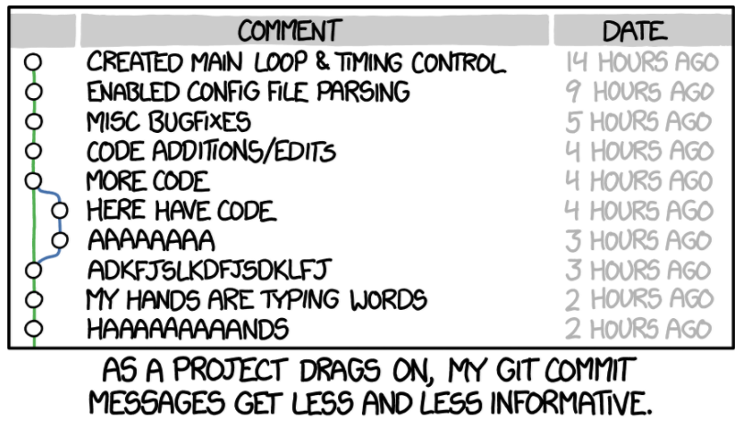
Commit Messages
Phrase your commit messages to fill-in-the-blank for this sentence:
"When this commit is applied, it will ______"
"Fix bug #1234"
"Remove redundant code"
"Enable lookup by customer last name"
"Apply consistent colors to all backgrounds in the user interface"
Use the present tense and imperative voice
Commit message tips: http://chris.beams.io/posts/git-commit/
No!
https://xkcd.com/1296/

Slide 9
Example of Bad Commit Messages
"Code"
"Working on adding feature"
"not working"
"need to add validation"
"Dave's code"
"Monday night work"
"everything as of 1/3/2019"
"Bunch of changes"
"wow much code yikes"
"commit"
"need to add another menu option next"
What's wrong with these?

Slide 10
Git at the command line
Open a command line, or terminal, or git bash
Verify git works at the command line by typing
git --version
If error:
Is Git installed? Install if not
Is the git executable on your path? Add it
Ask if you need help

Slide 11
Change directory to wherever you keep your code
Your own computer: use cd commands to change to that directory
Lab computers: type these, replace STARID with your own starID
Command Prompt:
C:
cd Users\STARID\
Or, Git bash:
cd /c/Users/STARID

Slide 12
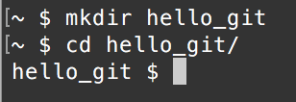
Make new directory for code Change to that directory
Remember git will keep track of everything in a directory as part of the same repository
So, one project per directory
That directory can have subdirectories if needed
Have one project and it's git repository in it's own directory
mkdir hello_git
cd hello_git

Slide 13

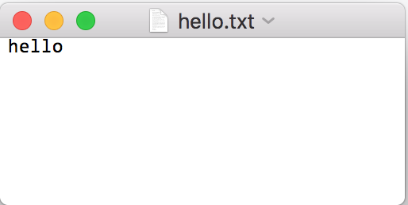
Make a new text file
Type this command - it copies the text "hello" into a new file called hello.txt
echo "hello" >> hello.txt
Optional: open this file in a
text editor. It should contain
'hello'

Slide 14
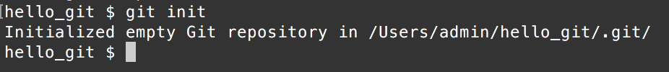
Create git repository git init
Verify your command line has the focus on the hello_git directory
Type git init
Should see a "Initialized empty Git repository... ' message
git init creates a repository, and tells git to manage everything in the current directory as part of the same repository,
in this case, the hello_git directory
Anything in subdirectories of hello_git will also be managed by git as part of the same repository

Slide 15
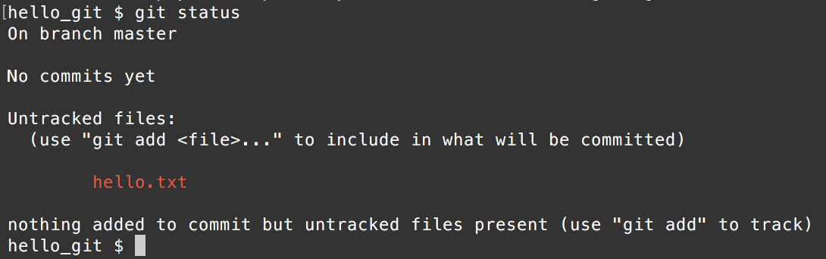
What's going on? git status
Now type git status
Shows some info about the state of your repo
This should show you what files are not tracked in the repo (in red) and what files have been changed since the last commit (in green)
You should see hello.txt as an untracked file

Slide 16

git add
git will ignore files it hasn't been told to track
Let's add hello.txt
Either: git add . to add everything in the current directory (you need the period . )
Or: git add hello.txt to add a specific file
Type git add .
When you are working at the command line, successful commands often don't have any output, but show error messages if something went wrong

Slide 17
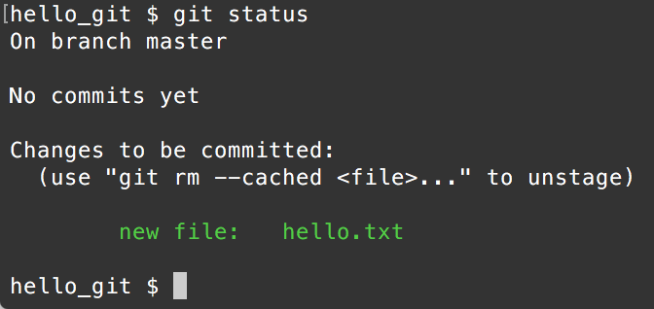
git status
Run git status again. What's different?
The added (staged) changes are in green
Any files in green will be added to the next commit

Slide 18
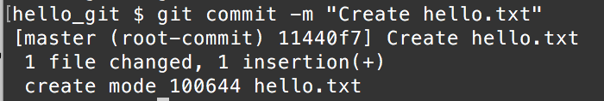
git commit
Commit the new file
git commit -m "Create hello.txt"
Mac/Linux can use double or single quotes
PCs must use double quotes

Slide 19
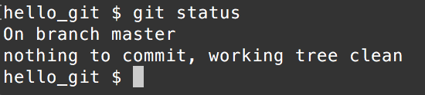
git status
Try git status again. What's changed?

Slide 20
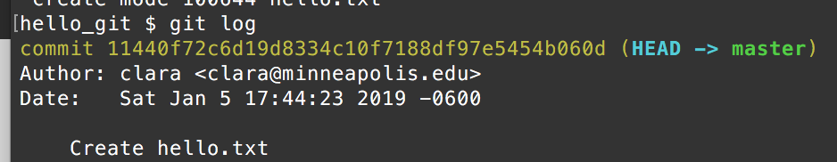
git log
Type git log to see a list of your commits
This long string is a SHA or a hash
Used to uniquely identify one commit
We'll use these later
Your hash will be different - they are all unique

Slide 21
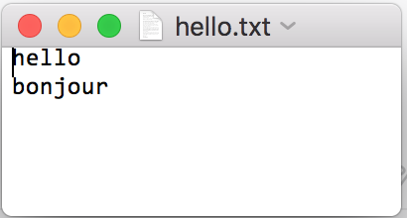
Modify hello.txt
Either add a new line that says "bonjour" in your editor
Or, type echo "bonjour" >> hello.txt
*bonjour is French for "hello" or "good day"

Slide 22
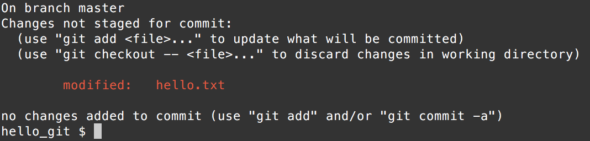
git status
Run git status
Git knows hello.txt has changed

Slide 23
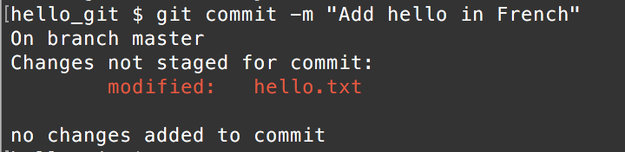
Commit
What happens if we try and commit?
No changes added to the commit - nothing happens
We have to stage (add) the changes before we commit

Slide 24
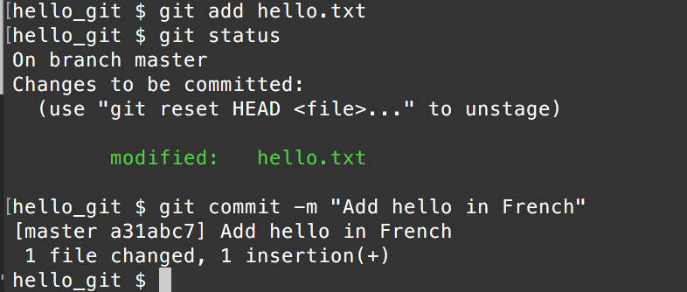
Add the changes and commit
git add hello.txt
git status
git commit -m "Add hello in French"
Notice hello.txt is staged

Slide 25
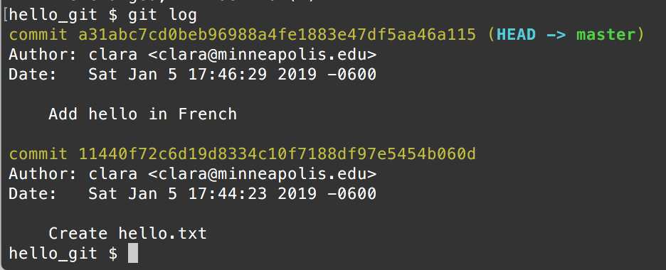
git log
git log should show both commits

Slide 26
Your turn
Add "hola" to hello.txt, save ("hello" in Spanish)
Run git status
Stage (add) hello.txt
Run git status to verify
Commit the change with a useful commit message
Run git status
Run git log

Slide 27
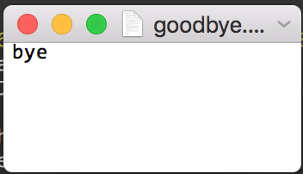
New File
Create a new file called goodbye.txt with "bye" in it

Slide 28
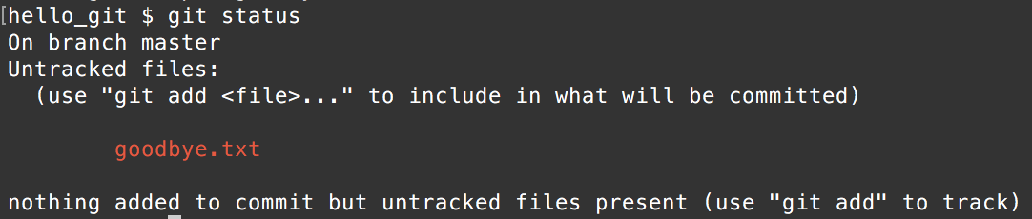
Run git status
Git has seen the new file

Slide 29
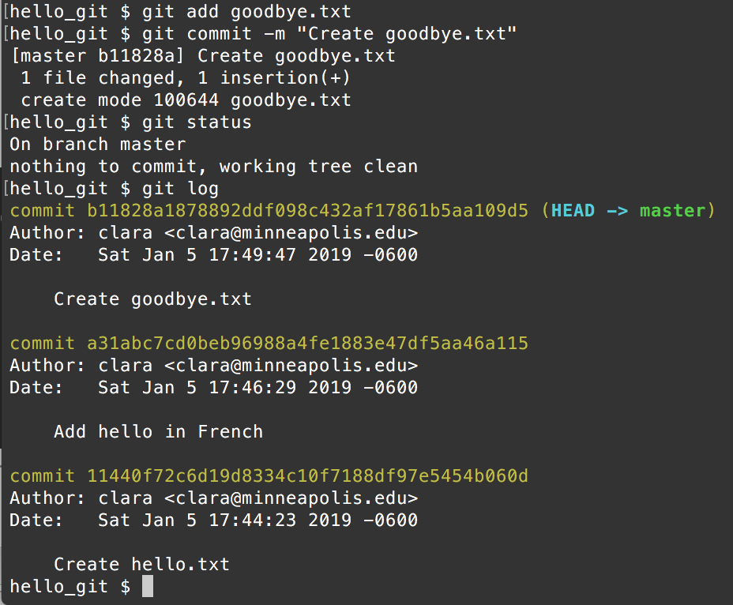
add, commit
git add goodbye.txt
git commit -m "Create goodbye.txt"
Run git log,
and git status

Slide 30
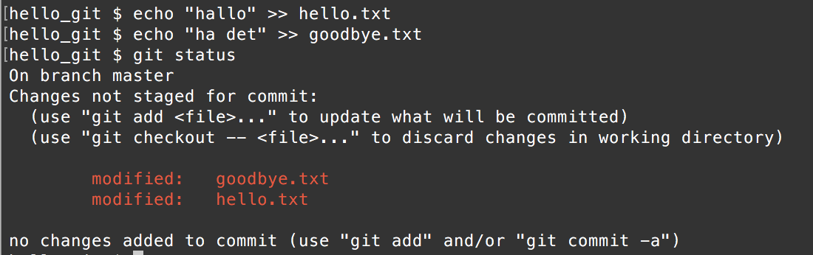
Modify more than one file
Let's add some Norwegian phrases...
Add "hallo" to hello.txt Add "ha det" to goodbye.txt
Run git status and note both changed files are listed

Slide 31
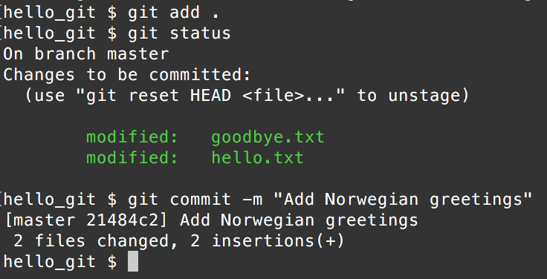
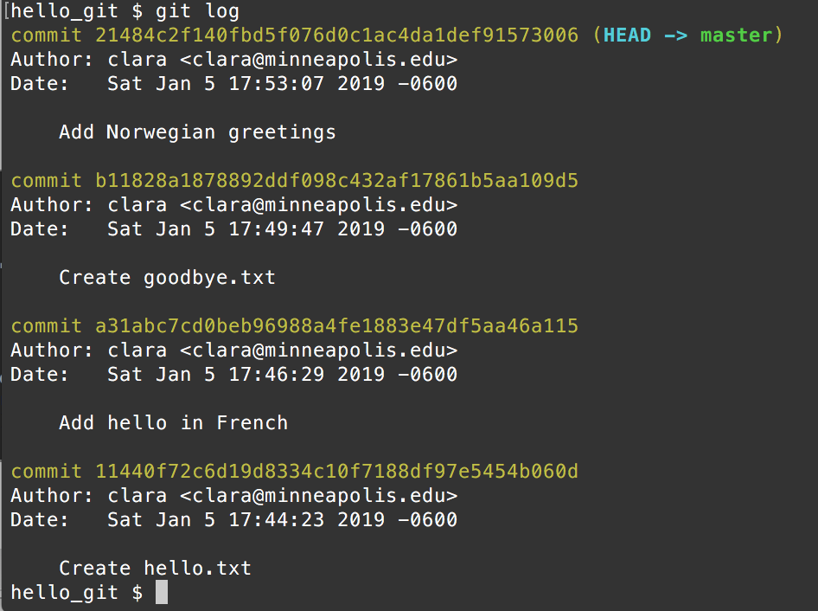
git add .
Run git add . to add all changes
git status to confirm
git commit -m "Add Norwegian greetings"
Run git log - can you see all the commits?
Run git status - should see the "nothing to commit" message

Slide 32
Remote repos
Create a repository at GitHub
Copy the URL for the repo

Slide 33
git remote add origin <url>
Type git remote add origin <url>
But replace <url> with your repository's URL
origin = where your remote code goes to. In a company, you'll work on a project that's already has a repo hosted somewhere, so you'll get the code, work on it, and push your changes back to the origin. In this case, origin is your GitHub repo.

Slide 34
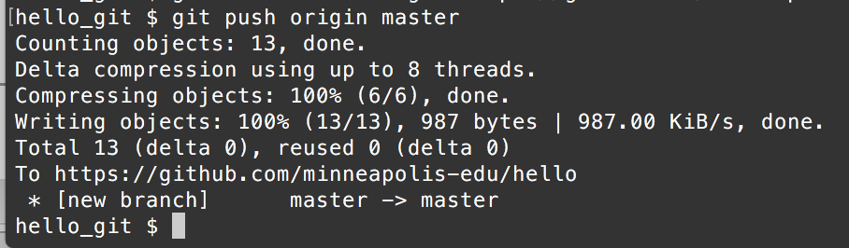
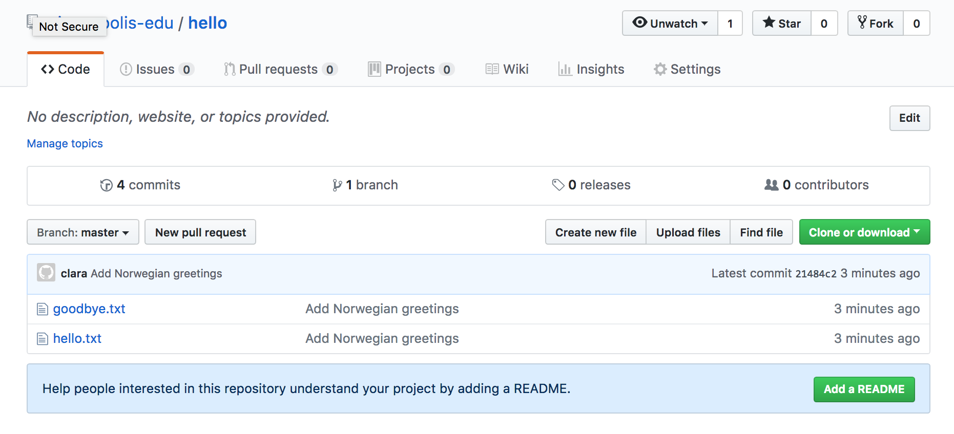
git push origin master
Push your work to GitHub with
git push origin master
git push origin master means "push the master branch to the origin". Or in other words, push all changes on the master branch since the last push, to GitHub

Slide 35
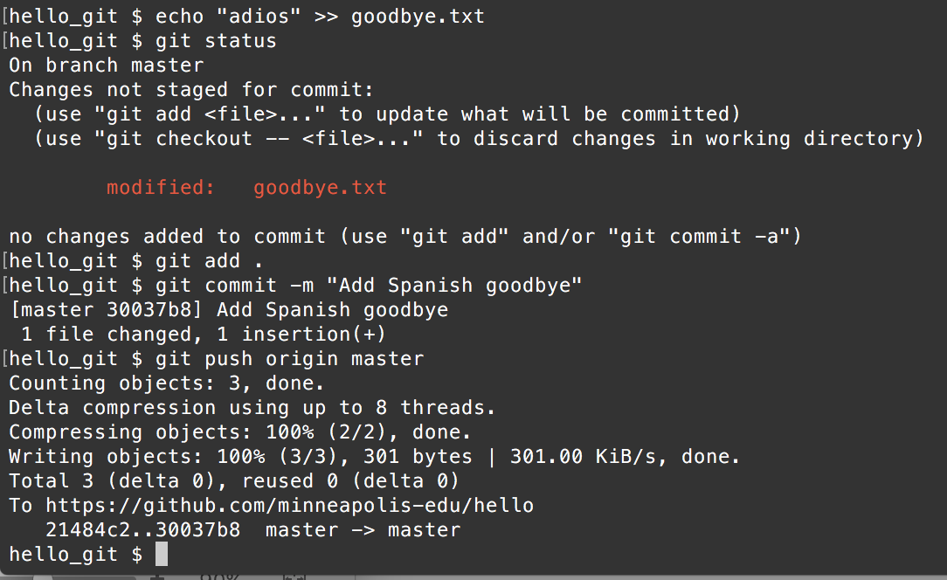
Add "Adios" to goodbye.txt
This time, we'll commit and push to GitHub
git status
git add .
git commit -m "Add Spanish goodbye"
git push origin master

Slide 36
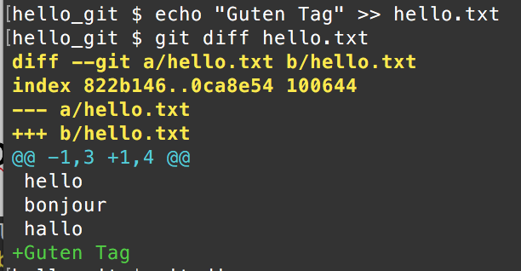
git diff (before files are added)
Often it's useful to see what has changed in a file
Modify one of your files, don't add
For example, add "Guten Tag" to hello.txt
Now run git diff on hello.txt
git diff hello.txt
Guten Tag = good day, hello in German

Slide 37
git diff
git diff all the differences in all the files
git diff hello.txt the differences in hello.txt

Slide 38
git diff (when files have been added)
After you add (stage for commit) a file, git diff ignores changes
git diff --staged all the differences in all the files
git diff hello.txt --staged the differences in hello.txt

Slide 39
Commit, push
Commit your latest change, use a descriptive commit message
And push to GitHub

Slide 40
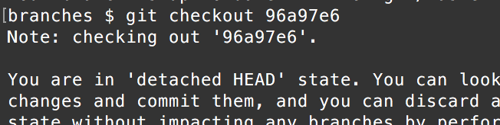
Viewing Code From Old Commit
Make sure all of your changes are committed
Find the commit hash you want to look at from git log
git checkout hash
You can use the first ~6 characters of a hash - it will still work
Important! You'll now be in "detached HEAD" state which means that git can't make new commits from here. Fix by checking out master (or whatever branch you want to be working with) before making any changes. Or, you can make a branch from this point (we'll look at branches soon)
Attach your HEAD with
git checkout master

Slide 41
Initializing git in the wrong place
Symptoms:
too many files in the repo - for example, files in directories above this one
No files, or not enough files are added after git add
Presence of a .git directory indicates the root of a git repository is initialized
It's a hidden directory
On windows, dir /a will show .git
On mac/linux, ls -a will show .git
Google "show hidden files in finder" or "show hidden files windows explorer" for steps to view in Windows Explorer or Mac's Finder
Make sure you've initialized your repo in the right place
To fix, you'll need to delete the .git directory to remove the repo and your history. You can't move a .git directory
Deleting .git will remove the repo and all history from a directory... this may be destructive so double-check that's what you want to do!!
If you've run git init from the root directory of your computer, you are not alone!

Slide 42
Part 2
Undoing Things

Slide 43
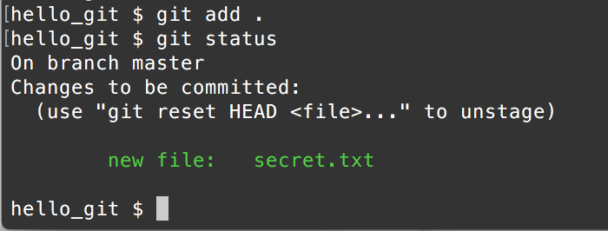
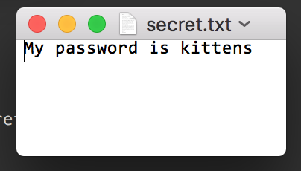
Removing files from repo - not yet committed
In your hello_git project, create a new file called secret.txt
Let's pretend this contains secret keys or passwords and you don't want to add it to the git repo, or push it to GitHub
But, you've accidentally run git add . and git is now tracking it - it will be added to the next commit

Slide 44
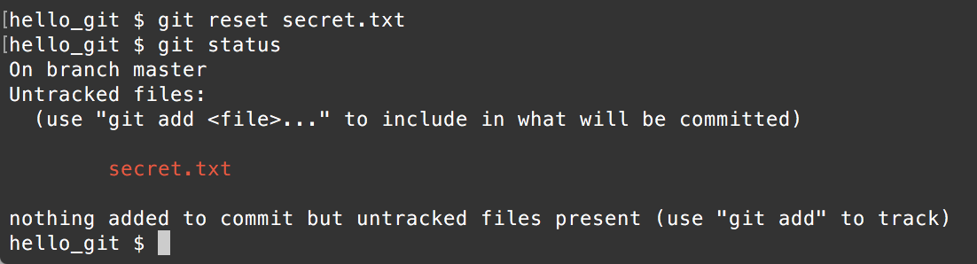
Remove a file you don't want in the repo: you added it but not committed
Remove it from being tracked by git; but keep the file:
git reset removes all files that have been added, but not committed
git reset secret.txt removes the named file
Use
git status to verify

Slide 45
Ignoring Files
Files you might want to ignore include
files with keys, passwords, secrets
Compiled code
Scratch files, notes
Log files
Temporary files
List files and filename patterns to ignore in a .gitignore file in the root directory of your project

Slide 46
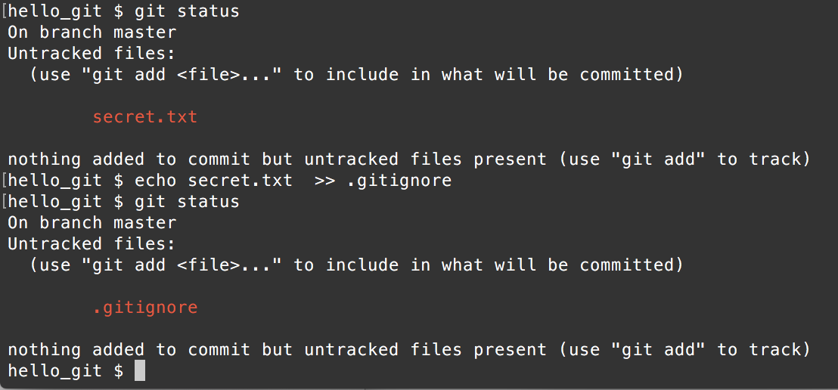
Create a .gitignore for secret.txt
Create a new file called .gitignore
echo "secret.txt" >> .gitignore
Now run git status - you should not see secret.txt
But, you'll see the new .gitignore file.
Run git add and git commit to add and commit the .gitignore file

Slide 47
Remove a file you don't want in the repo: when you've committed the file
E.g. you accidentally added and committed a file
Remove it from being tracked by git; but keep the file, with this:
git rm --cached yourfilename.txt
or for a directory, add -r for recursive removal
git rm -r --cached yourdirectory
note: the --cached is important!
git rm yourfile.txt will delete the file from git and from your file system!
If this is a file with keys/secrets in, revoke/reset these and request new ones
Update .gitignore to ignore this file
git add and git status to verify

Slide 48
Try it out
Create a new file called topsecret.txt
Write some top secret text in it
Add to your repo and commit
Oops! Remove topsecret.txt from your repo with git rm --cached topsecret.txt
Add topsecret.txt to .gitignore
Add changes and commit

Slide 49
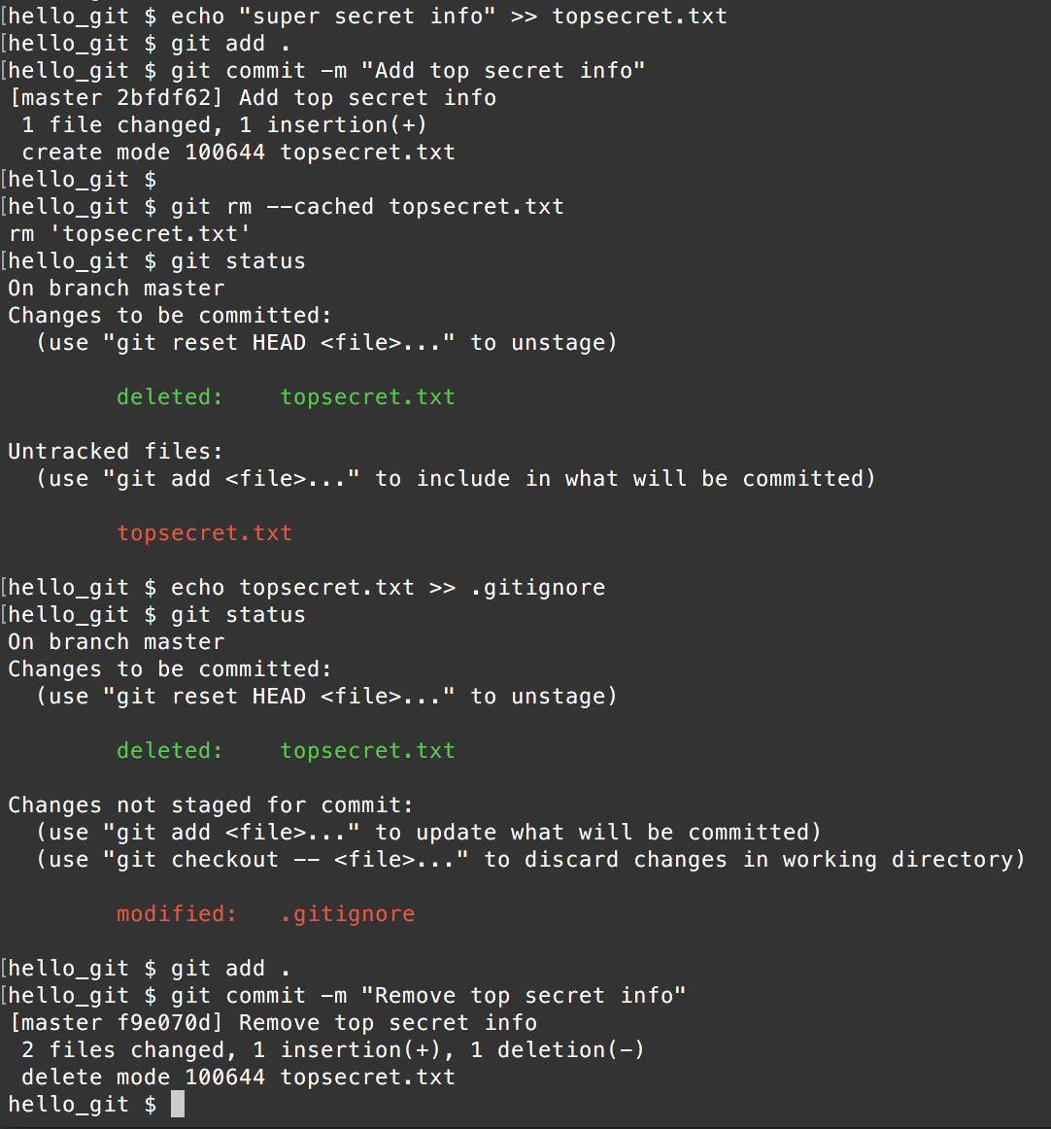
Try it out
Oops, didn't mean to commit this file
Remove from repo, keep on disk
Add to .gitignore
Add and commit changes. Deleting a file from a repo is a change so you need to add the delete

Slide 50
Reverting changes: hard reset
You've been making commits
After the last commit, you have made changes but things are not going well. You have not yet committed the new changes
You want to revert to the last commit
git reset --hard
Changes are deleted and gone
Your project is reverted to the state of the last commit
Warning! You won't be able to get uncommited changes back!
You can't get code back that was never committed: so commit often!

Slide 51
Reverting code to a previous commit - hard reset
Which commit do you want to revert to?
Type
git log
And locate the commit hash (SHA) of the commit
you want to go back to
git reset --hard ca0276ec81c50fb15df34ab38cec4
or
git reset --hard ca0276ec8
Will modify the files on disk to the commit specified

Slide 52
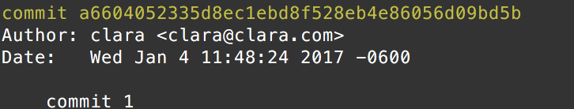
revert commits, keep code: soft reset
Which is the last good commit do you want to revert to?
Type
git log
And locate the commit hash (SHA) of the commit
you want to go back to
git reset ca0276ec81c50fb15df34ab38cec4
or
git reset ca0276ec8 (at least 7 chars, enough to be unique)
This will keep your code as it is on disk, but git will be at that last commit; subsequent commits are gone
HEAD is moved to the ca0275ec8 commit - the one reset to
SHA - this long hex number

Slide 53
Git HEAD
HEAD is a reference to the last commit in the current checked out branch
When you create a new repository, you get a branch called master
HEAD points to the last commit you made on that branch
Make more commits, each time HEAD is updated to refer to the latest commit
Check out a branch, make a commit? HEAD now points to that commit

Slide 54
Undoing things with git
Bookmark this!
https://github.com/blog/2019-how-to-undo-almost-anything-with-git

Slide 55
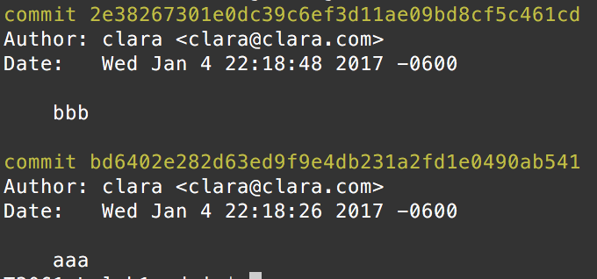
Trying it out
1. Create a new directory with one file in called a.txt
2. Type "aaaa" into a.txt, save
3. Set up git repository
git init
git add .
git commit -m "aaa"
4. Add some more text ("bbbbbb") to a.txt, save, git add ; git commit
5. View log with
git log

Slide 56
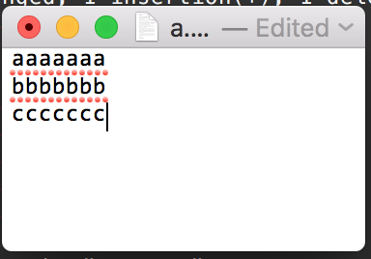
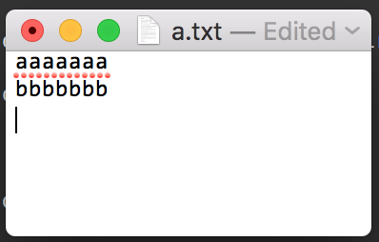
Trying it out
6. Add some more text "cccc" to a.txt, save the file, but don't commit
7. Type git reset --hard
What happens to a.txt?
Reverted to last commit,
changes gone
Changes are not committed
git reset --hard

Slide 57
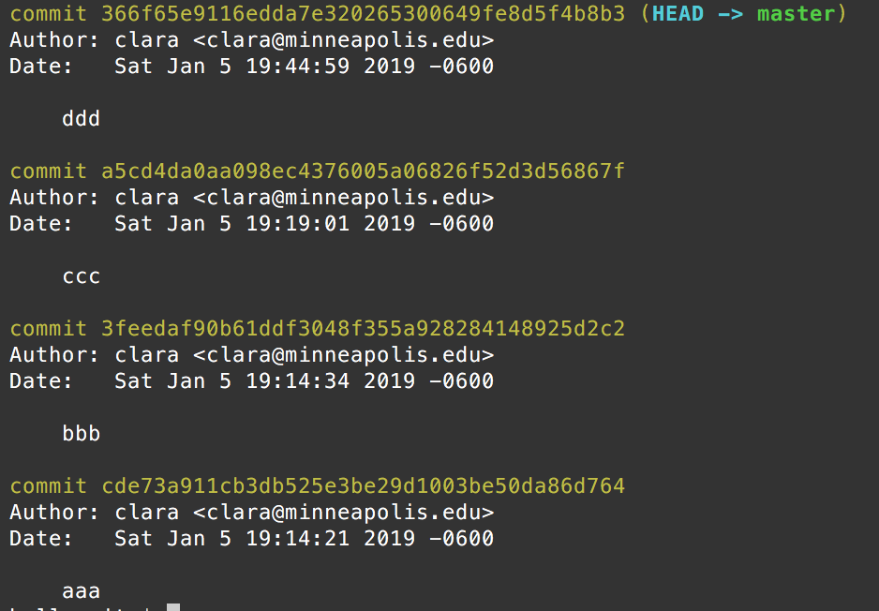
8. Add "cccccc" in a.txt.
9. Save, git add a.txt, git commit -m "cccc"
10. Add "ddddd" to a.txt. Save, git add, git commit -m "ddd"
10. Make a note of the commit hash for ccc
Yours will be
different to mine

Slide 58
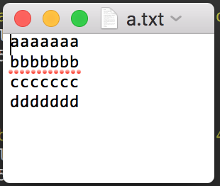

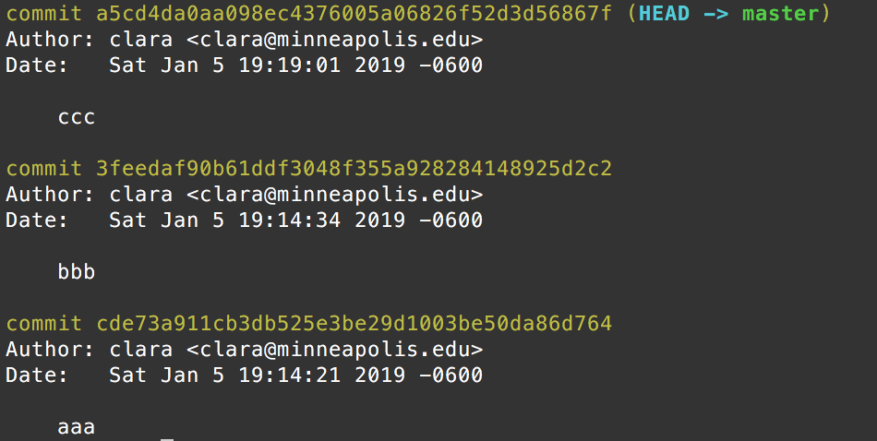
Soft reset Reset (remove) commits, keep code
git reset hash
Replace hash with first ~6 characters of the commit hash of your ccc commit
git reset hash
code same as ddd commit
ddd commit
Repository at ccc commit, changes to a.txt are unstaged

Slide 59

Hard Reset - reset commits, reset code
13. Add and commit, message "ddd"
14. Do a hard reset to the ccc commit
git reset --hard hash
Replace hash with your ccc commit hash
This time, what happens to a.txt?
code same as ccc commit
git reset --hard hash
ddd commit
Repository at ccc commit, changes to a.txt are gone

Slide 60
Warning
WARNING ok to do this with your local changes, before they are pushed to GitHub. BUT avoid this with published changes in a shared repository - changes that have been pushed to GitHub - you'll force everyone else to reset and they may not be happy about that. If you need to reset in a shared project, talk to your collaborators about the best approach.

Slide 61
Viewing Code From Old Commit
Add and commit any changes
Or reset --hard, or stash
Find the commit hash you want to look at
git checkout hash
important! You'll now be in "detached HEAD" state which means that git can't make new commits from here. Fix by checking out master (or whatever branch you want to be working with) before making any changes. Or, you can make a branch from this point (we'll look at branches next)
Attach your HEAD with
git checkout master

Slide 62
Part 3
Branching

Slide 63
Branches
So far, your repository's history has been linear, one commit after the other
There's some problems with this, in larger projects
What if you want to implement a new feature, but aren't sure how things will go, or if you'll be able to finish it all right now? Or if you want to include it in the project right away?
How can people collaborate in one repo? How can they keep their work in progress from interfering with other's work?
How can development on different features be managed?

Slide 64

Branches
Git repos always have one branch called master
Once the project is underway, the master branch often contains a working version of the project
Branches are used to organize work
Create more branches in addition to master
Need a new feature? Create a branch, develop the feature on the branch. Don't touch master. Once feature is done, the branch can be merged into master
So if you break the project, or the code doesn't work, it doesn't affect master branch
You can pause work on a branch without affecting master
Many people can create branches and work on their own features without affecting others
Branches can be merged in any order
Project manager can merge in branches to master
Master branch

Slide 65
Branching and Merging
Features should be developed in branches
To add a feature:
create a branch,
work on code to add feature
merge branch into master when feature done
Keeps changes compartmentalized and organized - really important in big projects
Start with your camelCase program from Lab 1 (or use the one on the next slide)
This file should be in a separate directory, with a git repository. Your changes should be committed
Let's add a welcome banner. As this is a new feature, create a new branch for the feature

Slide 66
camelcase.py example
def camelcase(sentence):
""" Convert sentence to camelCase, for example, "Display all books"
is converted to "displayAllBooks" """
title_case = sentence.title() # Uppercase first letter of each word
upper_camel_cased = title_case.replace(' ', '') # remove spaces
# Lowercase first letter, join with rest of string
# Slices don't produce index out of bounds errors.
# So this still works on empty strings, strings of length 1
return upper_camel_cased[0:1].lower() + upper_camel_cased[1:]
def main():
sentence = input('Enter your sentence: ')
output = camelcase(sentence)
print(output)
if __name__ == '__main__':
main()

Slide 67
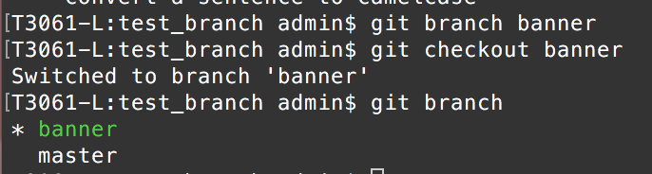
Create branch
Commit any changes before making a branch
Type this to create a branch
git branch banner
And then check out that branch
git checkout banner
You can see a list of branches, and which one is currently checked out, with git branch
OR create branch and check it out, all in one command:
git checkout -b banner

Slide 68
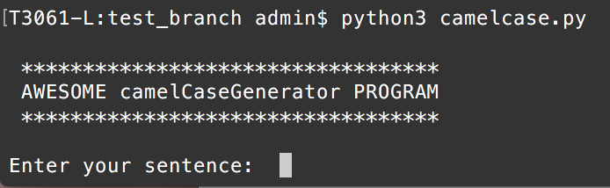
Add the banner feature
def camelcase(sentence):
""" Convert sentence to camelCase, for example, "Display all books"
is converted to "displayAllBooks" """
title_case = sentence.title() # Uppercase first letter of each word
upper_camel_cased = title_case.replace(' ', '') # remove spaces
# Lowercase first letter, join with rest of string
# Slices don't produce index out of bounds errors.
# So this still works on empty strings, strings of length 1
return upper_camel_cased[0:1].lower() + upper_camel_cased[1:]
def display_banner():
""" Display program name in banner """
msg = 'AWSOME camelCaseGenerator PROGRAM'
stars = '*' * len(msg)
print(f'\n {stars} \n {msg} \n {stars}\n')
def main():
display_banner()
sentence = input('Enter your sentence: ')
output = camelcase(sentence)
print(output)
if __name__ == '__main__':
main()

Slide 69
Feature complete!
Commit the changes
git add .
git commit -m 'add program name banner'
If you had more work to do on the banner feature, you'd make more commits as you work
Once the feature is done, merge banner branch into master branch
!! This is NOT the same as merging master into banner !!

Slide 70
Merge banner into master
Check out master
git checkout master
merge banner into master
git merge banner
Now you are on the master branch, with the banner changes merged in
Verify you've still got your banner code in camelcase.py

Slide 71
Your Turn
Add a new feature: printing instructions after the banner, but before the user enters the sentence.
Create a new branch called instructions
Check out this branch
Add the feature (print something like "Enter a sentence to convert to camelCase")
Add and commit changes
Check out master
Merge instructions into master
Use git status, git log, git branch as you work to check on the status of your repository

Slide 72
Forgot to make a branch?
You start working on a feature, but you are working on master - you forgot to make a branch for your feature
Solution:
Make a new branch. Don't check it out yet. new_feature branch points to your most recent commit (most recent work).
git branch new_feature
You should be on master. Hard reset master to the commit before you started working on the feature - your changes will be saved in the new_feature branch. Look up the hash in the log
git reset --hard hash
Now check out new_feature branch and keep working on the feature. When it's done, merge as before
git checkout new_feature

Slide 73
Part 4
Collaboration

Slide 74

Collaboration
Work in pairs. I'm going to refer to the students as Mulder and Scully.
Mulder:
Fork this project to your GitHub account
https://github.com/claraj/guess_the_number
In your repository, click on Settings, then Collaborators
Add Scully's email or GitHub username
Scully: accept Mulder's invite to collaborate - check your email

Slide 75
Enable and Create Issues
One of you: click on the Settings tab and check the ‘Enable Issues’ checkbox
The original repository has two issues, make copies of these in your fork
Issues are not copied to forks
Mulder: create one issue – ‘Add validation for user input’
Scully: create another issue ‘Count the number of guesses the user makes’
* Using Issues is independent of the merging/branching/collaborating process. Being familiar with issue trackers to manage bugs and feature request is useful, you'll use this at work.

Slide 76
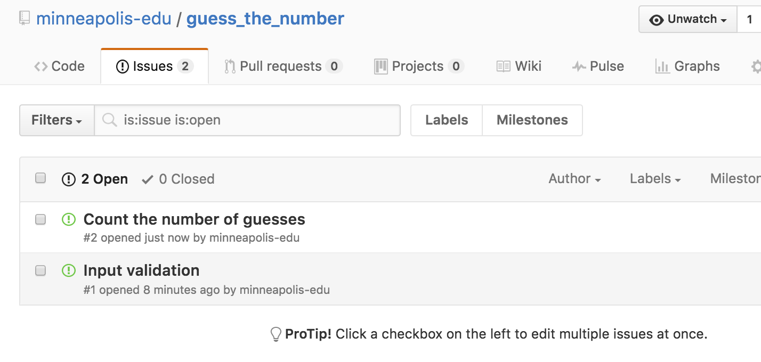
Assign Issues
Mulder: assign yourself one of the issues
Scully: assign yourself the other one

Slide 77
Clone this repository to your own computers
Mulder and Scully: make sure you are in a directory that doesn't already have a repository in it
Download code from GitHub with
git clone https://github.com/username/guess_the_number
Replace username with Mulder's username
Code downloads into new directory called guess_the_number
Type the following to navigate into this directory
cd guess_the_number
* Everything would work the same if Mulder or Scully created the project from scratch; except whoever created it wouldn't need to git clone it, they'd already have it.
** You can also use git clone to get an initial copy of a project onto another computer, for example work on a lab computer; push code; on your own computer, git clone the repo

Slide 78
Fix the issues
Let's fix Mulder's issue first
Mulder: create a branch called validation
git branch validation
Check out that branch
git checkout validation
Fix the issue
maybe add try-catch to the get_guess function?
Commit
Ready to add the code to the project? Push the validation branch to GitHub
git push origin validation

Slide 79
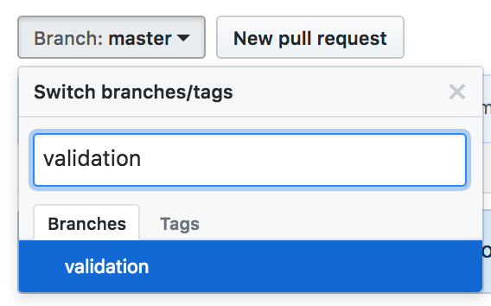
Checking Mulder's Work
On a big project, it's common to have programmers check each other's work before it's merged to master
Mulder, go to GitHub and notice you have an option to create a pull request
If not, click on the Branch: master dropdown and click on the validation branch, then New Pull Request

Slide 80
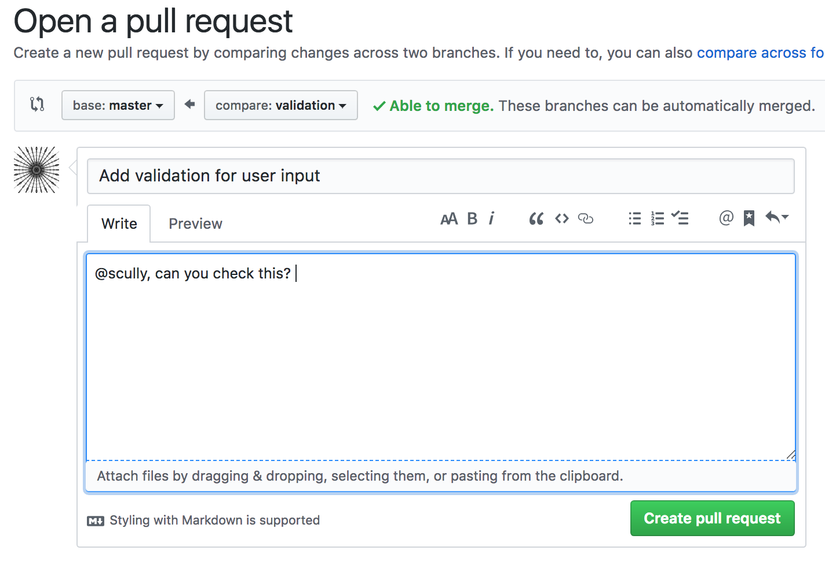
New Pull Request
Click the Compare & Pull Request or New Pull Request button
Scroll down to see the changes you've made

Slide 81
Pull Request (PR)
You are requesting that the repository administrator/owner, pull your code into the main repo
It's common for developers to review each other's work.
So, fill out the Write box, and tag Scully with @your_partner_github_name (but use your partner's actual GitHub name!)
Click Create Pull Request

Slide 82
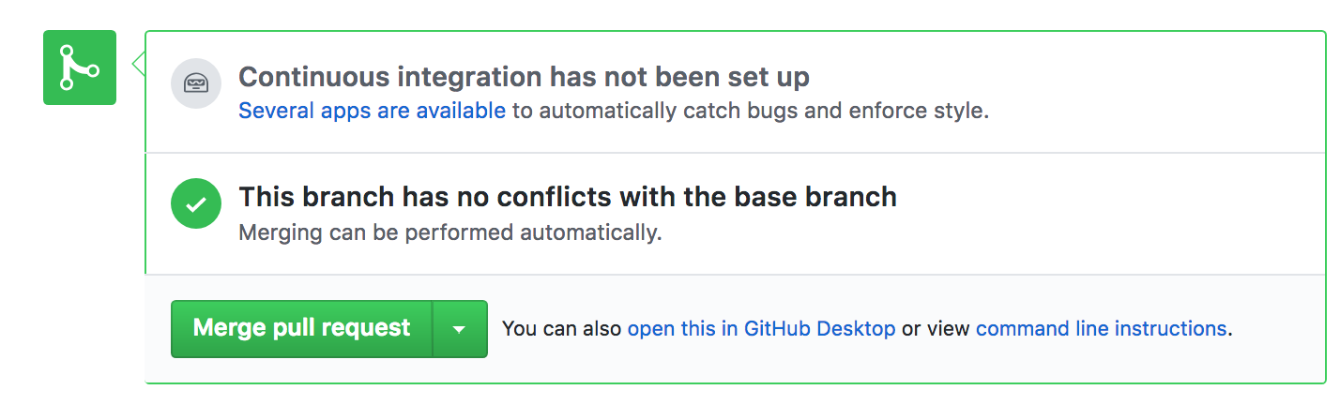
Reviewing Pull Request
Scully, you should get a notification in your GitHub account
Check out Mulder's code. Does it look ok?
If not, comment on the Pull Request and explain why not. Scully can close the Pull Request and keep working
If it looks good, it can be merged into Master
Click Merge Pull Request, and Confirm Merge

Slide 83
Updating Local Repos
Since Mulder's changes have now been merged into master, both Mulder and Scully want to get the latest code
git checkout master
git pull

Slide 84
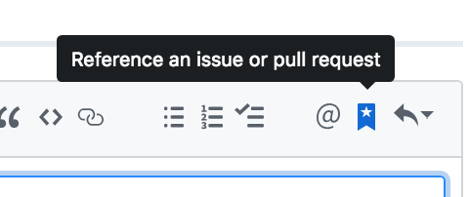
Closing the issue
Whoever merged the pull request, go to the Issue tab
Find the validation issue
It's helpful to link issues to the pull requests that fixed them, so write a short note and include a link to the PR
Click Close and Comment
Click on this icon, and select the pull request that fixed this issue

Slide 85
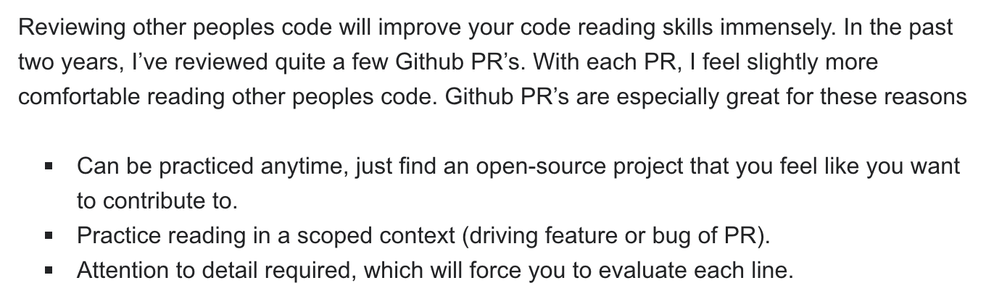
Reviewing is very important
As a developer, you'll read a lot of code
To add code to a project, you have to read and understand the code that is already there
To fix bugs, you need to read and understand the buggy code
https://stackoverflow.blog/2019/08/07/what-every-developer-should-learn-early-on/

Slide 86
Scully, fix your issue
Scully:
Create a branch called count_guesses
Check out count_guesses
fix issue
git add, git commit
git push origin count_guesses

Slide 87
Scully: create pull request
Create pull request
Write a short comment and tag Mulder
Mulder, review Scully's code
Merge if code is acceptable
Close issue, include link to pull request
Communicate with Scully if not

Slide 88
git pull
Good idea to git pull to get the latest changes before beginning work
git pull before pushing changes
This will error if there are merge conflicts, which you'll need to fix before pushing your code
Imagine in a real project, there may be many people working on a project. You typically need to fix your conflicts with their combined work - what's in GitHub - not the other way around

Slide 89
Merge conflicts
When you fix these two issues, you should modify different parts of the code, so should be no conflicts
But, it's possible for Mulder to modify code one way, and Scully to modify it a different way
If you both push changes, one may overwrite the other
What happens when you combine your changes - Mulder pushes changes, Scully makes changes that will conflict locally, then pulls Mulder's changes?

Slide 90
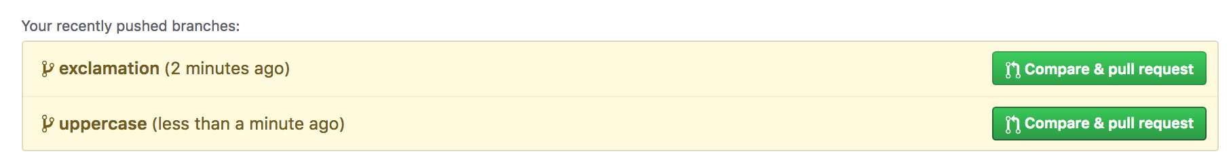
Create a merge conflict
Mulder:
Create branch exclamation, modify the global variable too_low to 'too low!!'
Add and commit changes; push exclamation branch to GitHub
Scully:
Create branch uppercase, modify the global variable too_low to 'Too Low'
Add and commit changes; push uppercase branch to GitHub
Go to Pull Requests and create a pull request for uppercase, confirm merge it into master
Now, open exclamation branch and create a pull request - notice the Can't automatically merge message

Slide 91
Merge Conflict
Often, git can figure out how to update master with the new code in a sensible way
But, when two people modify code in different ways, git doesn't know which changes should be applied
So, it prevents merging and you have to fix the conflict
How the conflict is fixed is up to the developer - maybe one code was correct, maybe the other, maybe a combination of both?

Slide 92
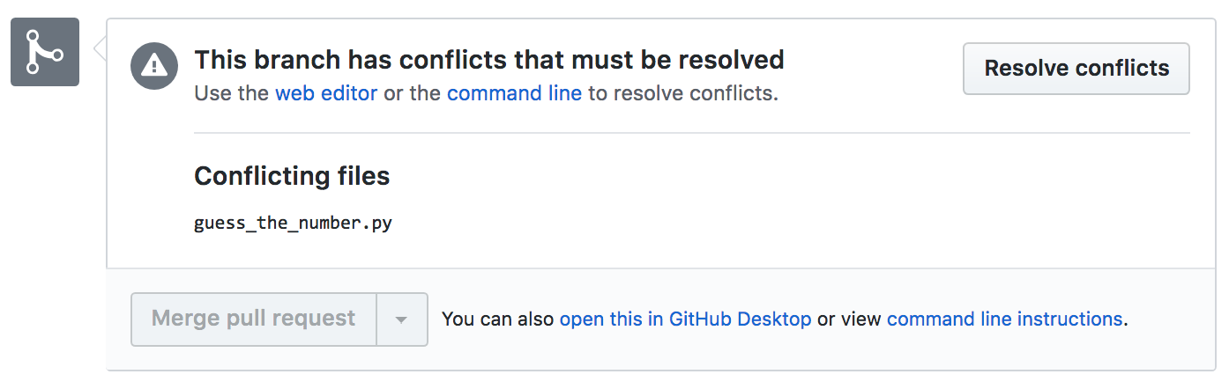
Merge Conflict
Can fix at the command line - for complicated conflicts
For simple conflicts, Click on the Resolve Conflicts button, and fix at GitHub

Slide 93
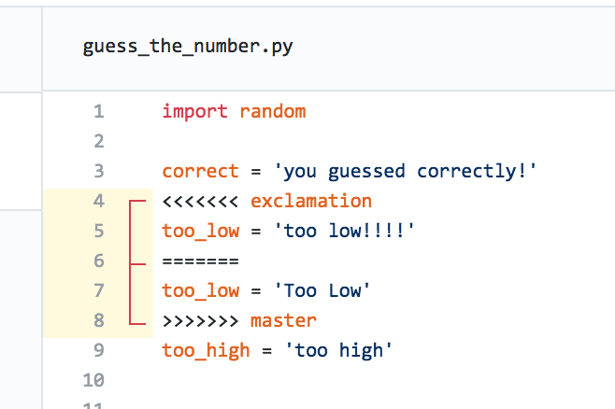
Merge conflict
Editor with merge conflict markers
<<<<<<
======
>>>>>>
Notice markers indicate what's in master, what's in exclamation branch

Slide 94
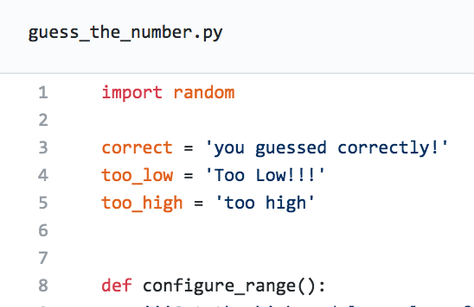
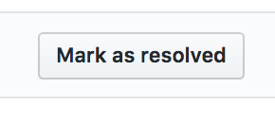

Use editor to fix conflict
Let's use a combination of both
too_low = 'Too Low!!!'
Delete the conflict markers
Click Mark as resolved, then commit merge
Now you can merge the pull request, and confirm merge

Slide 95
Fixed conflict
Both: git checkout master and git pull to get latest version including resolution
Both: verify you have the latest code

Slide 96
Creating issues
Create two more issues #3 and #4
Ability to configure the range of the random number generated (e.g. the user should be able to specify they want a random number between 1 and 100)
Ability to play again without re-running the program
Either of you can create issues - create one each
Assign one issue each to Mulder and Scully
You can self assign, or assign to someone else

Slide 97
Fix the issues
How will you fix them without overwriting the code written by the other person?
Communication is important - decide who will be working on what part(s) of the project
Create pull requests, review before merging, close issues as they are done
Fix merge conflicts if you encounter any
Remember to switch to master and git pull often to keep up to date with other student's changes

Slide 98

Fixing merge conflicts locally
The github editor is fine for simple conflicts, but for more complex code it's better to fix in your text editor
You can fix syntax more easily, and you can run the code/tests to make sure things work
In the pull request, click the command line instructions link, and follow the directions

Slide 99
Advanced Topics
What if you are working on a project, you are part-way through working on a branch, but some other issue is fixed in master, and you'd like to have that code in your branch?
Rebasing...https://nathanleclaire.com/blog/2014/09/14/dont-be-scared-of-git-rebase/
What if your feature is really complicated, and you want to split your branch into smaller branches?
Can branch from a branch, and another branch from that branch... https://nvie.com/posts/a-successful-git-branching-model/

Slide 100
Next: Lab, Project 2
Finish the guess the number problem
Project 2, in pairs: book reading list
Goal of this project: good git & project workflow, branching, PRs and code review
Communication - slack and via issue tracker
Issue management & tracking
Pull requests and reviewing
Branching (and maybe merging)
Atomic commits
The code is not especially hard. Majority of your grade is for professional git workflow, USING PULL REQUESTS, REVIEWING CODE, communicating, commit messages, using the issue tracker

